Slide 1
Solution for effective utilization of coir raw material to avoid wastage
PIP2001 Capstone Project
Review-1
Batch Number: CST-G18
Under the Supervision of,
Mrs. Shaik Salma Begum
Professor
School of Computer Science and Engineering
Presidency University
Roll Number | Student Name
20211CST0006 | Nagaruru Sunandhan
20211CST0039 | Bobbiti Yaswanth Reddy
20211CST0041 | Kruthika S
Name of the Program: Btech
Name of the HoD: Dr. Saira Banu Atham
Name of the Reviewer: Dr. Saira Banu Atham
Name of the Program Project Coordinator: Dr. H M Manjula
Name of the School Project Coordinators: Dr. Abdul Khadar A

Slide 2
Introduction
Coir raw material often goes to waste due to insufficient real-time data on its availability and demand within the market.
This project aims to develop a platform where farmers and industries can efficiently track, manage, and utilize coir resources, addressing the issue of wastage.
The platform offers real-time information on coir raw material availability, enabling industries to plan and source resources effectively.
The system involves farmers, industries, and data analytical firms, all of whom register with valid credentials, ensuring transparency and trust.
By improving the management and utilization of coir, the platform aims to reduce wastage and significantly increase profitability for all stakeholders involved.

Slide 3
Literature Review
Utilization of waste coir fibre architecture to synthesize porous graphene oxide and their derivatives [Krishna K. Yadav ,Harish Singh, Supriya Rana (2020)].
Uptake of dyes by a promising locally available agricultural solid waste [Namasivayam, R. Radhika (2000)].
Utilization of coconut waste for production of activated carbon and its application as a low-cost adsorbent in environment treatment [Hoang,Thi Cam Quyen Ngo (2023)].
A state-of-the-art review on coir fiber-reinforced biocomposites [Hasan, Miklos Bak, Tibor Alpar​ (2021)].
Effective utilization of natural fibres (coir and jute) for sustainable low-volume rural road construction [Nitish Kumar, Ramesh K. Kandasami (2022)].
Coir Geotextile-Packed Conduits for Wastewater Treatment [A. Praveen, P. B. Sreelakshmy 2008].

Slide 4
Literature Review
Physical and Chemical Properties of Coir Waste and Plant Growth[P.Noguera, M.Abad (1997)].
Coir from Coconut Processing Waste: Applications Beyond Traditional Uses. [Wolfgang Stelte, Narendra Reddy(2022)]
Coconut coir waste, a new and viable ecologically- Friendly peat substitute [Patricia Noguera,M. Abad(2000)]
Coir Waste Management for Hydroponics in Berries [Dr Doris Blaesing, RM Consulting Group(2011)]

Slide 5
Existing method Drawback
Lack of a Real-Time Resource Management System.
No Direct Interaction Between Stakeholders.
No Waste Prevention or Optimization Strategy.
No Farmer-Centric Features.
No Transaction Records for Data Analysis.

Slide 6
Proposed Method
The proposed solution involves creating a centralized web platform where various stakeholders—such as farmers, industries, and data analytics firms—can track, update, and manage coir raw materials. This includes :
Registration & Authentication: Secure system for transparent user registration.
Data Collection: Farmers provide real-time updates on coir availability via web or SMS.
Material Search: Industries access real-time availability data and place orders.
Transaction Recording: Automatic logging of transaction details in a database.
Data Management: Centralized database for storing user, availability, and transaction data.
Analytics: Firms access transaction data for analysis and trend forecasting.
Communication: SMS and web-based notifications for seamless communication.

Slide 7
Objectives
To manage and track coir raw materials.
To reduce coir raw material wastage.
To improve resource allocation.
To streamline transactions.
To Ensure transparency.
To include farmers in remote areas.
To support decision-making.

Slide 8
Methodology/Modules
User Management Module : Manage user registrations, authentication, and roles.
Coir Stock Management Module : Allow farmers and industrialists to input and update their coir stock information.
Industry Requests Module : Enables industries to accept selling requests of coir materials from different farmers.
Transaction Module : Keeps recent transaction information of users.
Data Analytics and Reporting Module : Provide analytics on stock levels and usage trends to help industries make informed decisions.
Feedback Module : Allow users to send feedbacks of website.

Slide 9
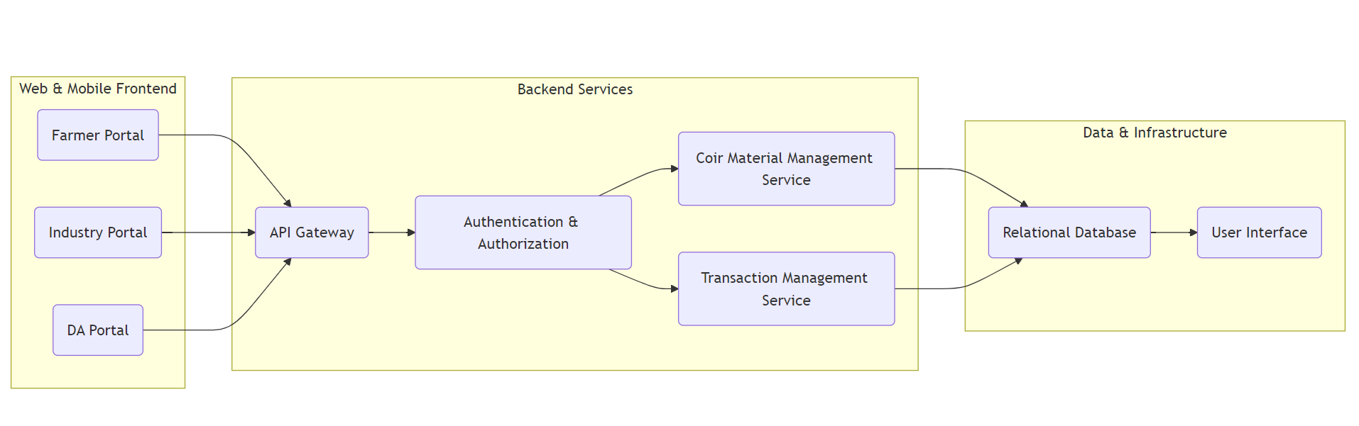
Architecture

Slide 10
Hardware/software components
Software Requirements: VS code, Django, MySQL
Technology Stack Components:
Frontend: HTML, CSS, JavaScript, Bootstrap. (using VS code)
Backend: Django, Python.
Database: SQLite (default), PostgreSQL/MySQL (optional).
User Authentication: Django Authentication System.
SMS API: Twilio/Vonage Messages API.
Version Control: Git and GitHub.

Slide 11
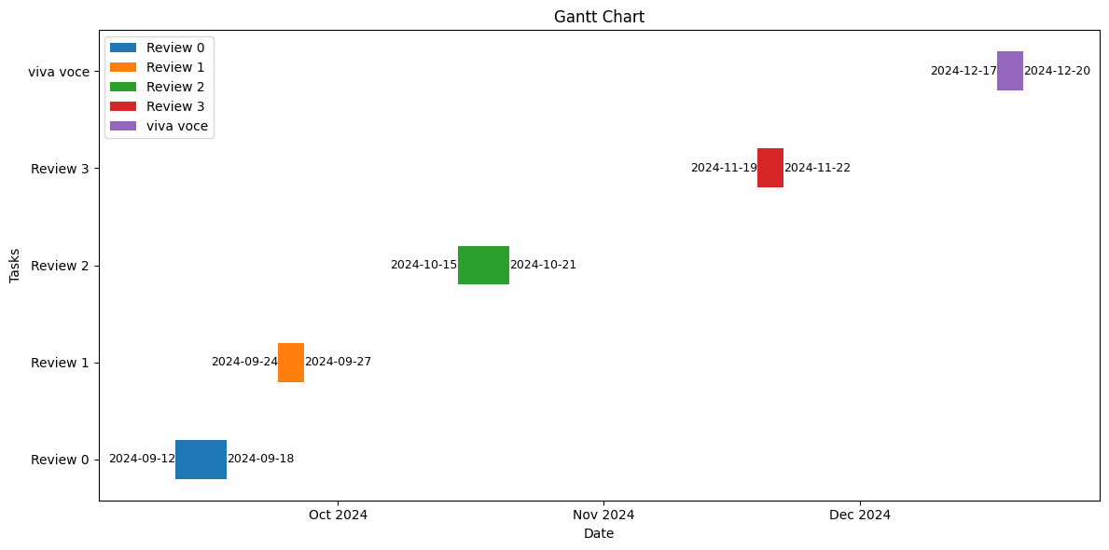
Timeline of Project

Slide 12
Expected Outcomes
Efficient Coir Utilization: Minimized wastage of coir raw material through real-time tracking.
Increased Farmer Revenue: Farmers can directly sell to industries, maximizing their earnings.
Expanded Market Reach: Farmers can access buyers beyond their local region.
Transparency in Transactions: Valid ID verification ensures transparency in all deals.
Reduced Middlemen Dependency: Direct farmer-to-industry sales eliminate unnecessary intermediaries.
Time and Cost Savings: Farmers and industries save time by using the platform for transactions.
Improved Decision-Making: Data analytics firms get organized transaction data for insights.

Slide 13
Conclusion
The proposed website facilitates efficient coir raw material utilization by connecting farmers, industry personnel, and data firms. It provides real-time updates on material availability, manages transactions, and ensures transparency through a centralized database. With both web and SMS access, farmers can easily update stock, while industry owners can source materials efficiently. The platform reduces wastage, supports data-driven insights, and optimizes resource use in the coir industry.

Slide 14
Github Link
Repository : Effective-utilization-of-coir-raw-material-to-avoid-wastage
Github Link
https://github.com/nanda898/Effective-utilization-of-coir-raw-material-to-avoid-wastage

Slide 15
References
Coconut coir waste, a new and viable ecologically- Friendly peat substitute https://www.researchgate.net/publication/286988277_Coconut_coir_waste_a_new_and_viable_ecologically-_Friendly_peat_substitute
Coir geotextile-packed conduits for the removal of biodegradable matter from wastewater https://www.jstor.org/stable/24102806
Coir from Coconut Processing Waste as a Raw Material for Applications beyond Traditional Uses https://www.researchgate.net/publication/365419789_Coir_from_coconut_processing_waste_as_a_raw_material_for_applications_beyond_traditional_uses
Effective utilization of natural fibres (coir and jute) for sustainable low-volume rural road construction https://www.sciencedirect.com/science/article/abs/pii/S0950061822022632
Coir from Coconut Processing Waste as a Raw Material for Applications beyond Traditional Uses https://researchprofiles.ku.dk/en/publications/coir-from-coconut-processing-waste-as-a-raw-material-for-applicat

Slide 16
References
A state-of-the-art review on coir fiber-reinforced biocomposites https://pubs.rsc.org/en/content/articlelanding/2021/ra/d1ra00231g
Utilization of coconut waste for production of activated carbon and its application as a low-cost adsorbent in environment treatment https://pubs.aip.org/aip/acp/article-abstract/2943/1/030006/2931471/Utilization-of-coconut-waste-for-production-of?redirectedFrom=fulltext
Uptake of dyes by a promising locally available agricultural solid waste https://www.sciencedirect.com/science/article/abs/pii/S0956053X00000817
Utilization of waste coir fibre architecture to synthesize porous graphene oxide and their derivatives https://www.sciencedirect.com/science/article/abs/pii/S0959652620342852
PHYSICAL AND CHEMICAL PROPERTIES OF COIR WASTE AND THEIR RELATION TO PLANT GROWTH https://www.actahort.org/books/450/450_45.htm
Coir geotextile-packed conduits for the removal of biodegradable matter from wastewater https://www.jstor.org/stable/24102806

Slide 17
Project work mapping with SDG
Provides coconut farmers direct access to markets, improving their incomes and reducing poverty in rural areas. (SDG-1)
By increasing farmer revenue, the platform contributes to food security and promotes sustainable agriculture. (SDG-2: Zero Hunger)
Encourages the inclusion of women in agriculture by providing equal access to the market and resources for female farmers. (SDG-5: Gender Equality)
Promotes decent work by connecting small-scale farmers to larger markets, ensuring fair trade and economic growth in rural areas. (SDG-8: Decent Work and Economic Growth)
Ensures efficient use of coir materials, minimizing waste and promoting sustainable consumption and production. (SDG-12: Responsible Consumption and Production)
Helps industries adopt eco-friendly practices by making coir, a sustainable raw material, more accessible. (SDG-13: Climate Action)
Facilitates partnerships between farmers, industries, and data firms to create a transparent, efficient, and collaborative ecosystem. (SDG 17: Partnerships for the Goals)

Slide 18


